Slide 2


Animation
Chris Piech
CS106A, Stanford University
This is Method Man. He is part of the Wu Tang Clan. ☺

Slide 3

Learning Goals
Feel more confident writing methods
Write animated programs

Slide 4
You will be able to write Bouncing Ball

Slide 5

Defining a Method
private void turnRight() {
turnLeft();
turnLeft();
turnLeft();
}

Slide 6
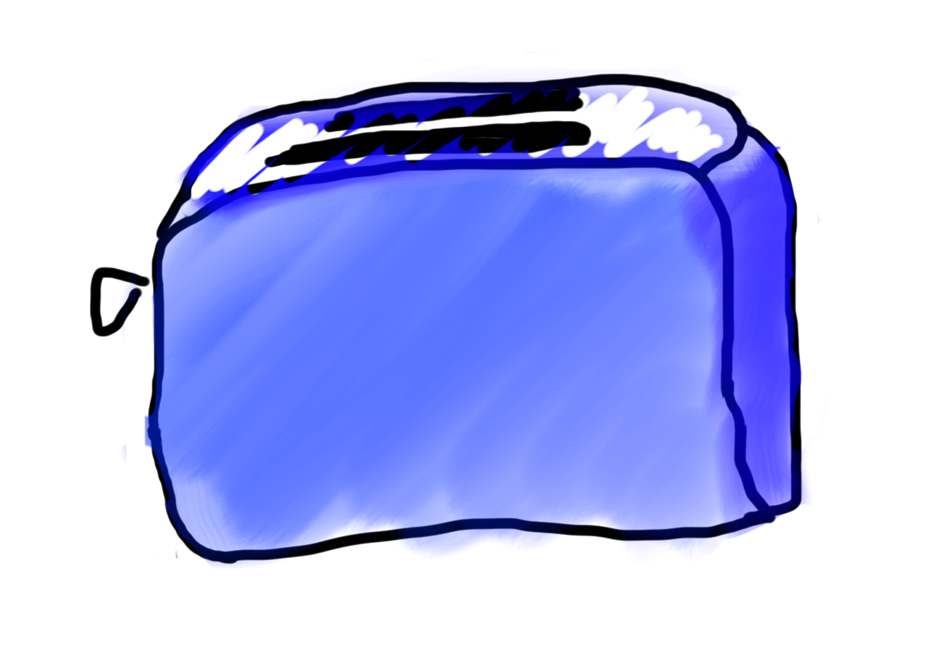
Methods are Like Toasters

Slide 7
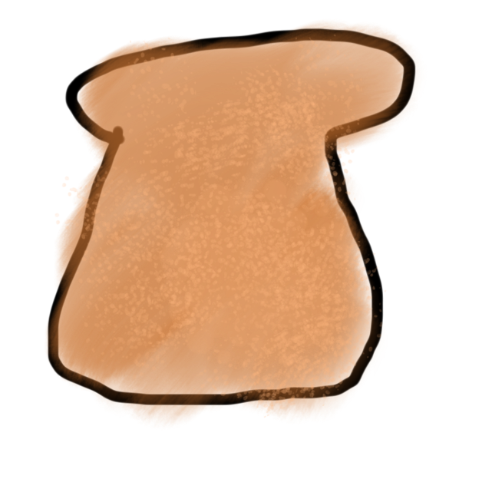
Methods are Like Toasters
parameter

Slide 8
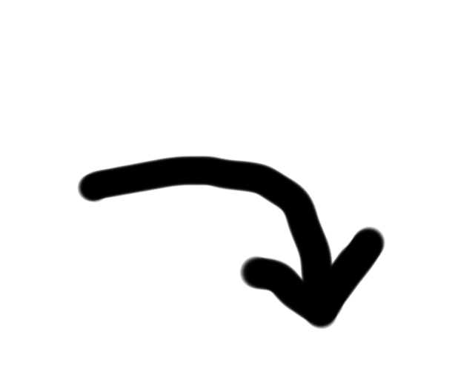
Methods are Like Toasters
parameter

Slide 9
Methods are Like Toasters

Slide 10

Methods are Like Toasters

Slide 11
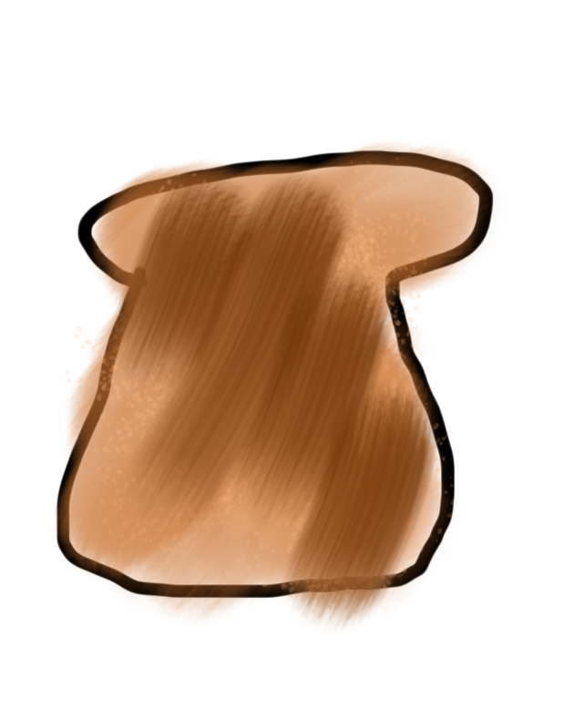
Methods are Like Toasters
return

Slide 12
Methods are Like Toasters

Slide 13
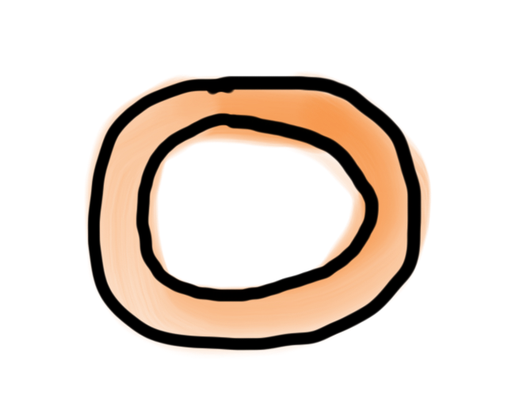
Methods are Like Toasters

Slide 14
Methods are Like Toasters

Slide 15
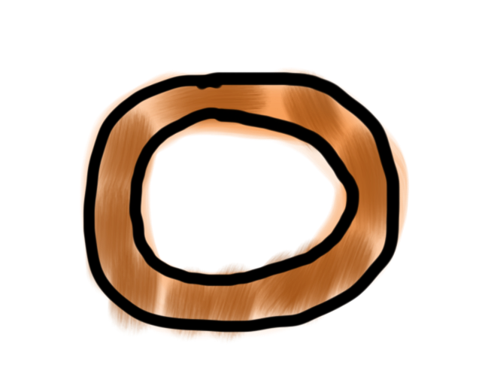
Methods are Like Toasters

Slide 16
Methods are Like Toasters

Slide 17
Methods are Like Toasters

Slide 18
Methods are Like Toasters

Slide 19
Methods are Like Toasters

Slide 20
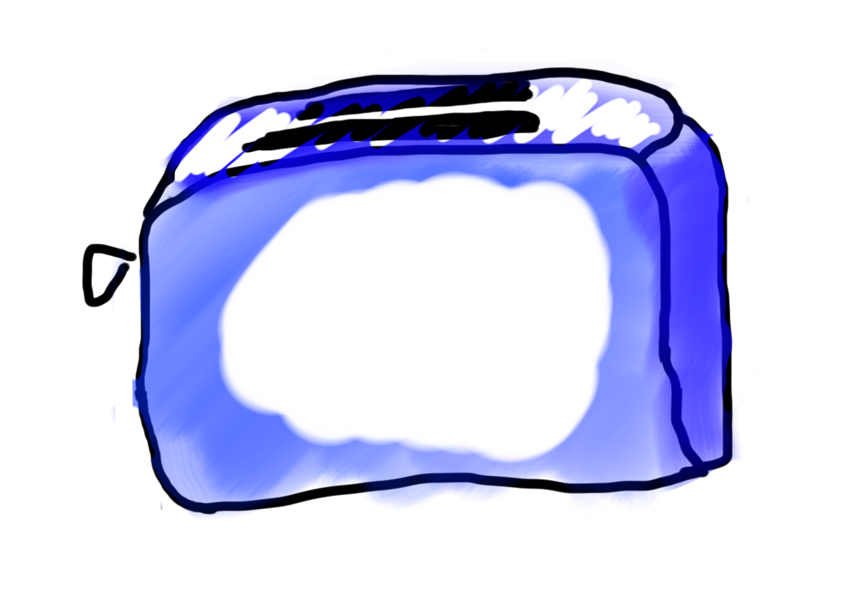
Methods are Like Toasters

Slide 21
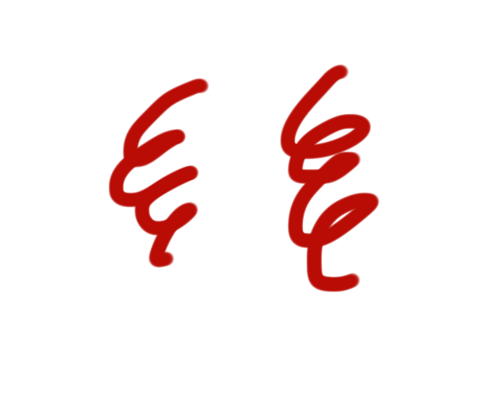
Methods are Like Toasters

Slide 22
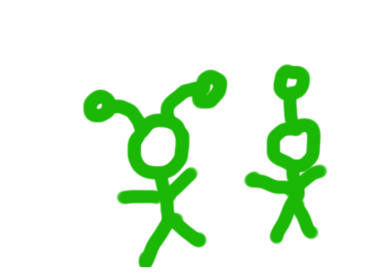
Methods are Like Toasters

Slide 23
Methods are Like Toasters
parameter(s)
return

Slide 24
Anatomy of a method
public void run() {
double mid = average(5.0, 10.2);
println(mid);
}
private double average(double a, double b) {
double sum = a + b;
return sum / 2;
}

Slide 25
Anatomy of a method
public void run() {
double mid = average(5.0, 10.2);
println(mid);
}
private double average(double a, double b) {
double sum = a + b;
return sum / 2;
}
method “definition”

Slide 26
Anatomy of a method
public void run() {
double mid = average(5.0, 10.2);
println(mid);
}
private double average(double a, double b) {
double sum = a + b;
return sum / 2;
}
Return Type
Parameters
Do not confuse return type with println. Both are “outputs” of sort.

Slide 27
Anatomy of a method
public void run() {
double mid = average(5.0, 10.2);
println(mid);
}
private double average(double a, double b) {
double sum = a + b;
return sum / 2;
}
name

Slide 28
Anatomy of a method
public void run() {
double mid = average(5.0, 10.2);
println(mid);
}
private double average(double a, double b) {
double sum = a + b;
return sum / 2;
}
body

Slide 29
Anatomy of a method
public void run() {
double mid = average(5.0, 10.2);
println(mid);
}
private double average(double a, double b) {
double sum = a + b;
return sum / 2;
}
Also possible to return a value

Slide 30
Anatomy of a method
public void run() {
double mid = average(5.0, 10.2);
println(mid);
}
private double average(double a, double b) {
double sum = a + b;
return sum / 2;
}
method “call”

Slide 31
Method for Weight on Moon
* Your weight on the moon is 16.5% your weight on the earth

Slide 32
As we left off..

Slide 33
Bad Times With Methods
// NOTE: This program is buggy!!
private void addFive(int x) {
x += 5;
}
public void run() {
int x = 3;
addFive(x);
println("x = " + x);
}

Slide 34
Good Times With Methods
// NOTE: This program is feeling just fine...
private int addFive(int x) {
x += 5;
return x;
}
public void run() {
int x = 3;
x = addFive(x);
println("x = " + x);
}

Slide 35
Primitive variables are not passed! Their values are.

Slide 36
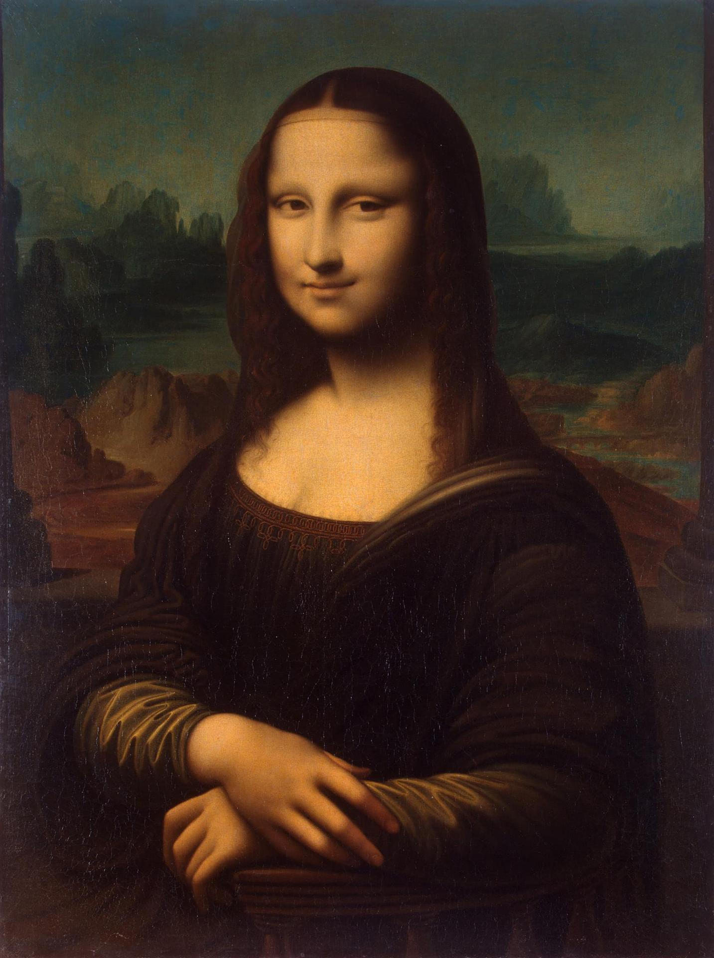
Pass by “Value”

Slide 37
More Examples

Slide 38
Changed Name
private void run() {
int num = 5;
cow(num);
}
private void cow(int grass) {
println(grass);
}

Slide 39
Same Variable Name
private void run() {
int money = 5;
retireEarly();
println(money);
}
private void retireEarly(){
int money = 1200000;
println(money);
}

Slide 40
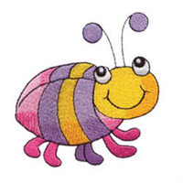
No Methods in Methods
private void run() {
println(“hello world”);
private void sayGoodbye() {
println(“goodbye!”);
}
}
Illegal modifier for parameter goodbye, only final is permitted
Huh?!?

Slide 41
No Methods in Methods
private void run() {
println(“hello world”);
sayGoodbye();
}
private void sayGoodbye() {
println(“goodbye!”);
}

Slide 42
Methods Called on Objects
GRect rect = new GRect(20, 20);
rect.setColor(Color.Blue);
receiver
* We will talk about how to define these later in the class

Slide 43
Remember Booleans?

Slide 44
Boolean Variable
boolean karelIsAwesome = true;
boolean myBool = 1 < 2;

Slide 45
Boolean Operations
boolean a = true;
boolean b = false;
boolean and = a && b;
boolean or = a || b;
boolean not = !a;

Slide 46
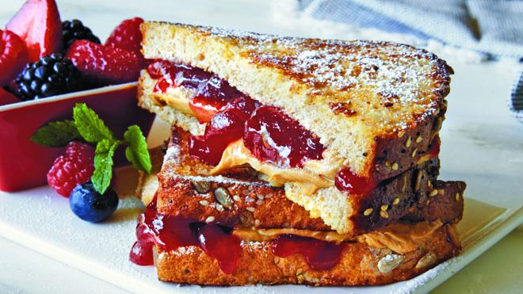

Slide 47
Is Divisible By
private void run() {
for(int i = 1; i <= 100; i++) {
if(isDivisibleBy(i, 7)) {
println(i);
}
}
}

Slide 48
Boolean Return
private void run() {
for(int i = 1; i <= 100; i++) {
if(isDivisibleBy(i, 7)) {
println(i);
}
}
}
private void isDivisibleBy(int a, int b) {
if((a % b) == 0) {
return true;
} else {
return false;
}
}

Slide 49
private void run() {
for(int i = 1; i <= 100; i++) {
if(isDivisibleBy(i, 7)) {
println(i);
}
}
}
private void isDivisibleBy(int a, int b) {
return a % b == 0;
}
Boolean Return

Slide 50
Move to Center

Slide 51
Animation Loop
private void run() {
// setup
while(true) {
// update world
// pause
pause(DELAY);
}
}

Slide 52
Animation Loop
private void run() {
// setup
while(true) {
// update world
// pause
pause(DELAY);
}
}
Make all the variables you need. Add graphics to the screen.

Slide 53
Animation Loop
private void run() {
// setup
while(true) {
// update world
// pause
pause(DELAY);
}
}
The animation loop is a repetition of heartbeats

Slide 54
Animation Loop
private void run() {
// setup
while(true) {
// update world
// pause
pause(DELAY);
}
}
Each heart-beat, update the world forward one frame

Slide 55
Animation Loop
private void run() {
// setup
while(true) {
// update world
// pause
pause(DELAY);
}
}
If you don’t pause, humans won’t be able to see it

Slide 56
Move To Center
private void run() {
// setup
GRect r = makeRect();
while(!isPastCenter(r))
// update world
r.move(1, 0);
// pause
pause(DELAY);
}
}

Slide 57
Animation in the CS Department

Slide 58
Bouncing Ball

Slide 59
Bouncing Ball
First heartbeat
Velocity: how much the ball position
changes each heartbeat

Slide 60
Bouncing Ball
First heartbeat
vx
vy
The GOval move method takes in
a change in x and a change in y

Slide 61
Bouncing Ball
Second heartbeat
vx
vy

Slide 62
Bouncing Ball
Third heartbeat
vx
vy

Slide 63
Bouncing Ball
What happens when we hit a wall?

Slide 64
Bouncing Ball
We have this velocity
vx
vy

Slide 65
Bouncing Ball
Our new velocity
vy
vx
When reflecting vertically: vy = -vy

Slide 66
Bouncing Ball
Seventh heartbeat
vy
vx

Slide 67
Bouncing Ball
Eighth heartbeat
vy
vx

Slide 68
Bouncing Ball
Ninth heartbeat
vy
vx

Slide 69
Bouncing Ball
We want this!

Slide 70
Bouncing Ball
This was our old velocity
vy
vx

Slide 71
Bouncing Ball
This is our new velocity
vy
vx
When reflecting horizontally: vx = -vx

Slide 72
Bouncing Ball
Tenth heartbeat
vy
vx
When reflecting horizontally: vx = -vx

Slide 73
Bouncing Ball

Slide 74
A Sticky Situation
This is our new velocity
The ball is above the bottom so we reverse its vy
The ball is bellow the bottom so we reverse its vy

Slide 75
Learning Goals
Feel more confident writing methods
Write animated programs

